Slide 1
Eagle Project Main Source RJ45
2D datasheet
2023/05/31

Slide 2
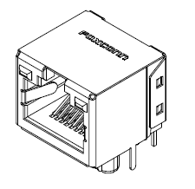
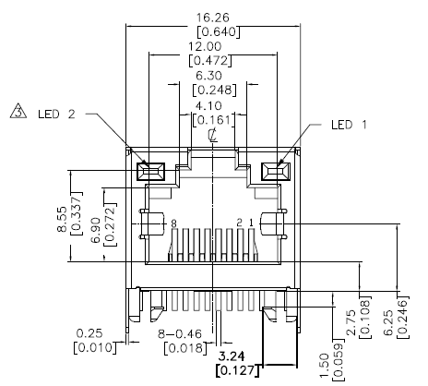
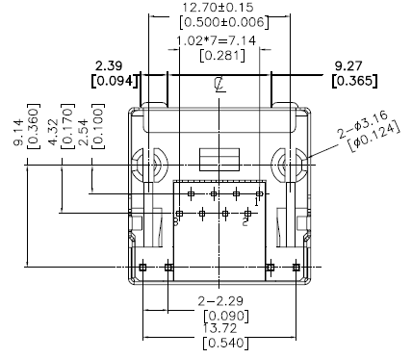
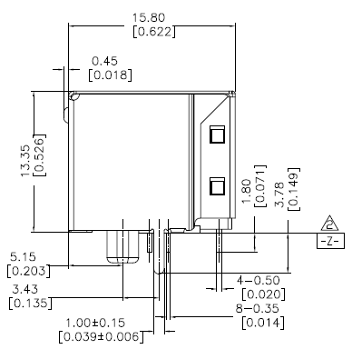
Main Source RJ45 2D datasheet 2d datasheet

